Slide 1
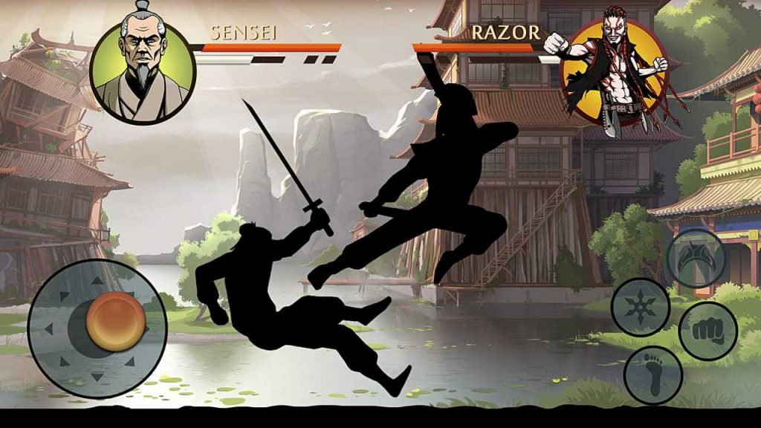
Shadow Fight MODS
All Mods Shadow Fight 2,3,4 and many more
https://shadowapkmod.com/shadow-fight-mods/

Slide 2

Shadow Fight MODS
https://shadowapkmod.com/
All Game Mods by Nekki

Slide 3
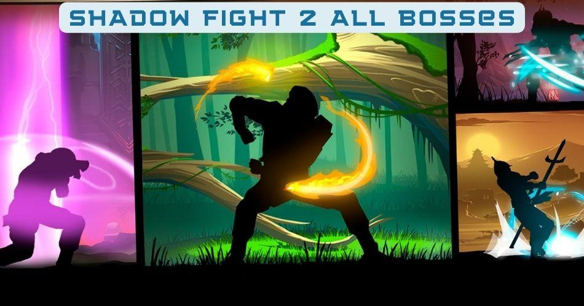

Slide 4
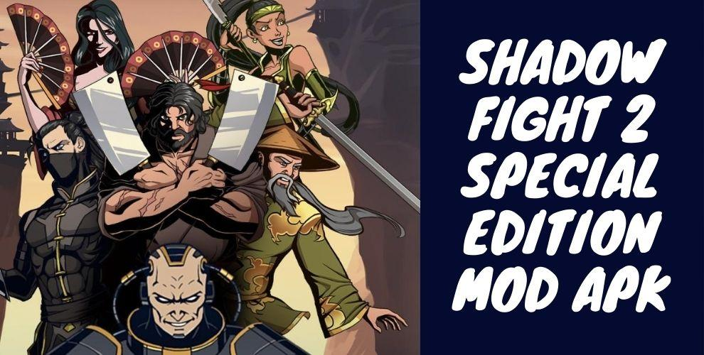

Slide 5
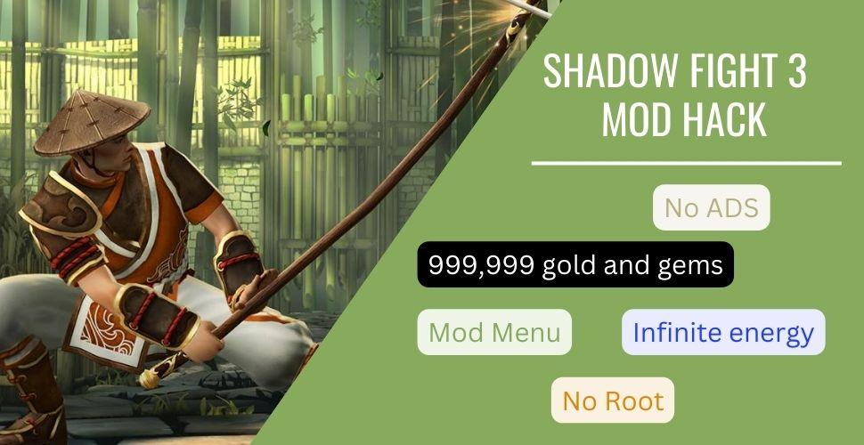

Slide 6
